Slide 1
IoT - Based Smart Village
MP Mini-Project
Team: Arvind Kumar (15EC106)
Jayanth Putta (15EC122)
Shantanu Vijay (15EC145)
Prof. In Charge: Dr Aparna P.

Slide 2
What’s the aim?
To make life easier for the villagers of Palampur.

Slide 3
Modules

Slide 4
Raspberry Pi
Healthcare
Transport
Warehousing
Irrigation

Slide 5
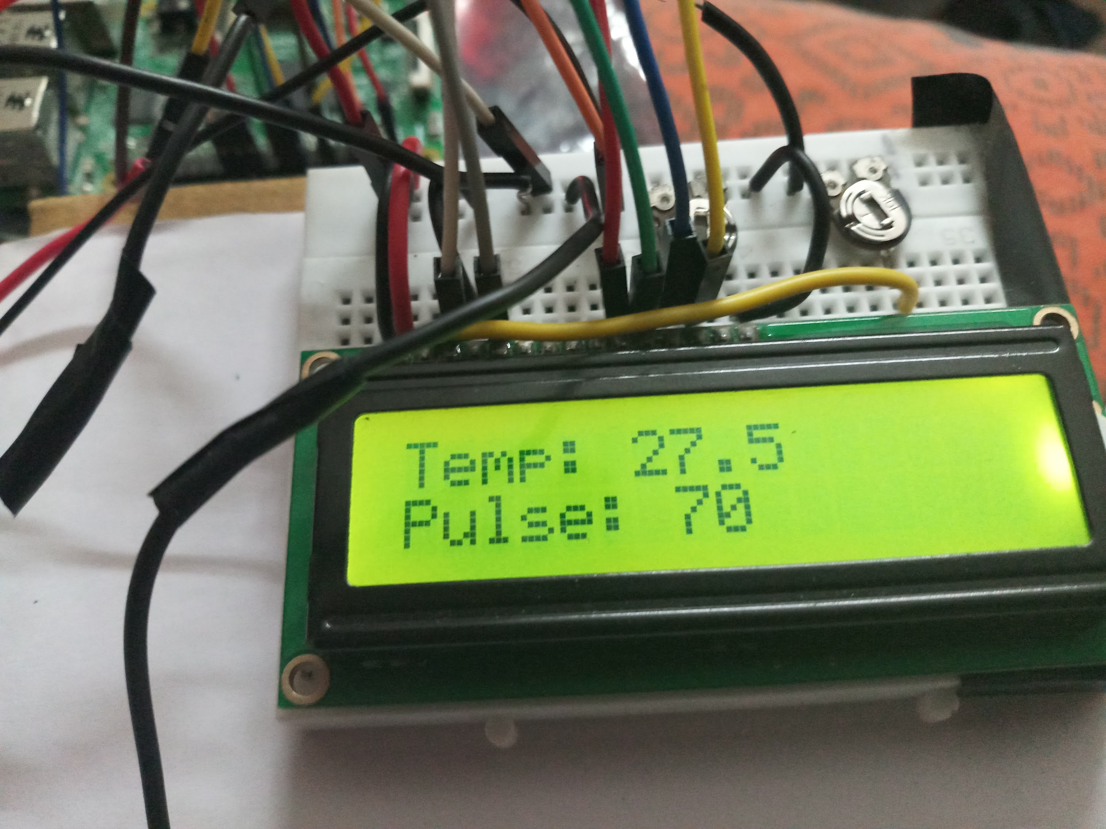
Healthcare - Smart Hospital Bed
Sensors: Temperature, Heartbeat
Outputs: Buzzer, LCD (16x2) , E-Mail
Patient data continuously recorded
Doctors can enter thresholds through a UI for the temperature and heartbeat (based on age, fitness levels, current medication, etc.)
If any abnormality is detected, the doctor is notified by email and local staff are notified by the buzzer

Slide 6
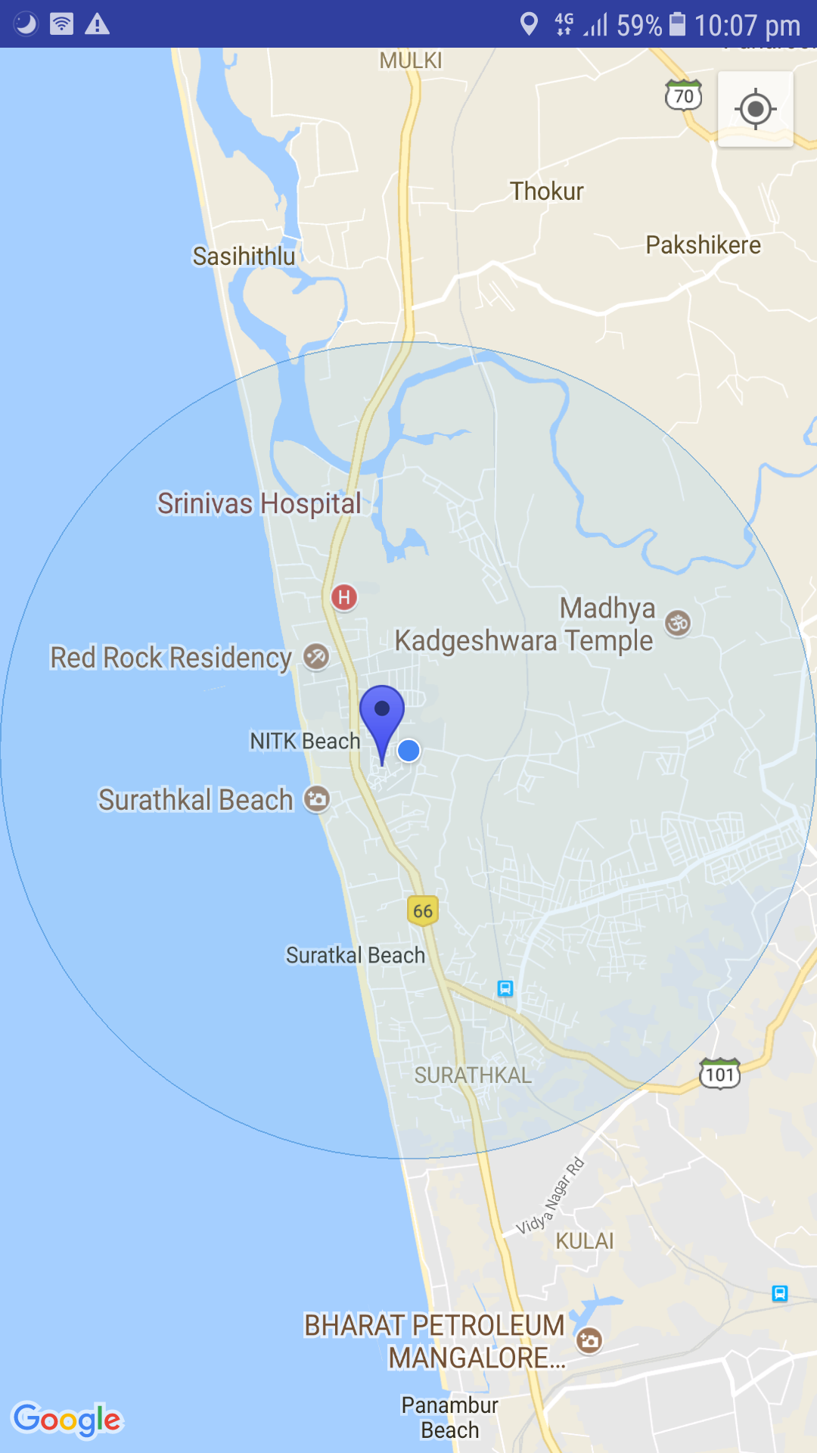
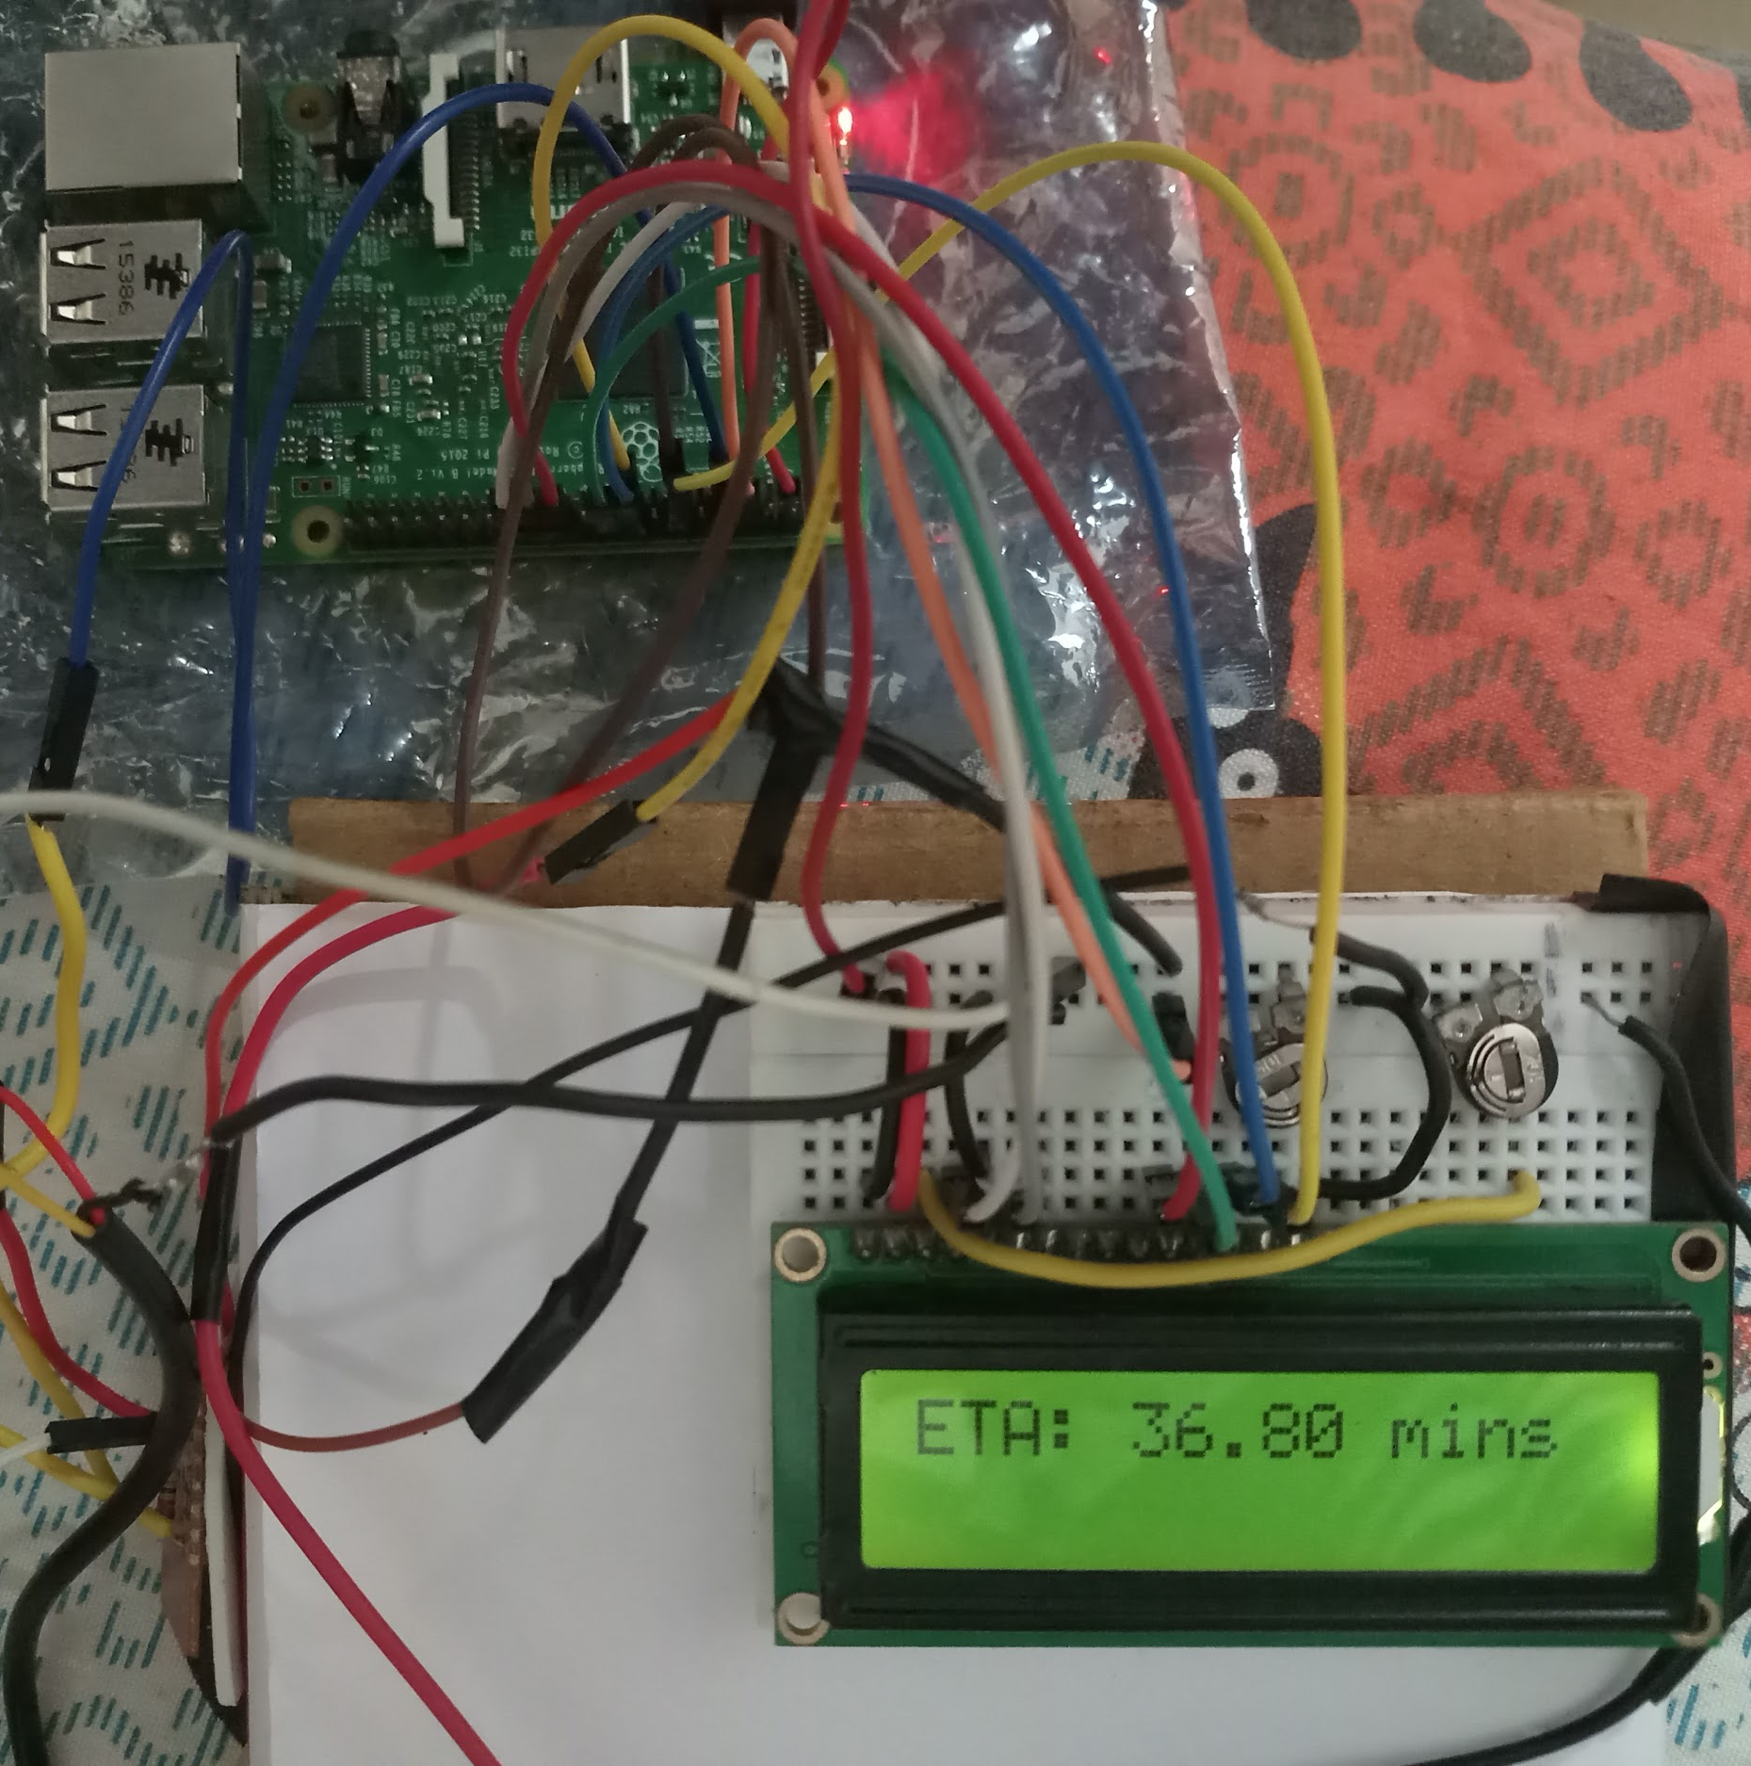
Transport - Bus Location with ETA
Collecting GPS data using a smartphone
Conductor will open the application and his location will be processed to find ETA
ETA data is transmitted wirelessly to the Raspberry Pi at the village and displayed on a 16x2 LCD screen
(The App)

Slide 7
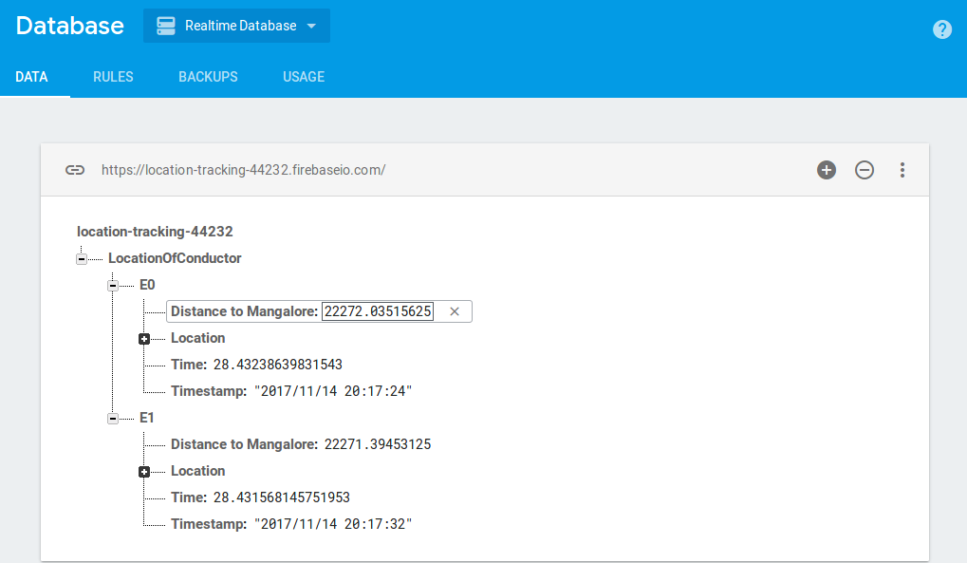

Firebase:

Slide 8
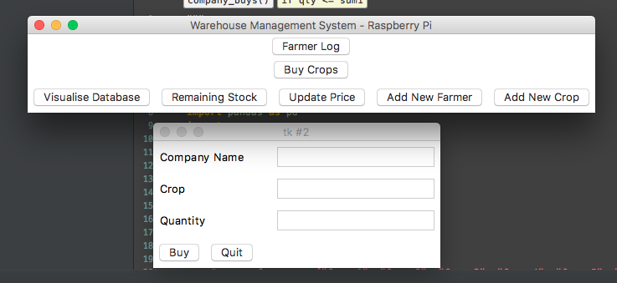
Warehousing
End-to-end system with many features
UI for farmers, warehouse administration and company which comes to buy crops
Keeps track of all new crops the farmers bring in and how much any company buys
Sends an email to the farmers telling them how much money is added when a company buys crops from the warehouse
Database visualisation

Slide 9
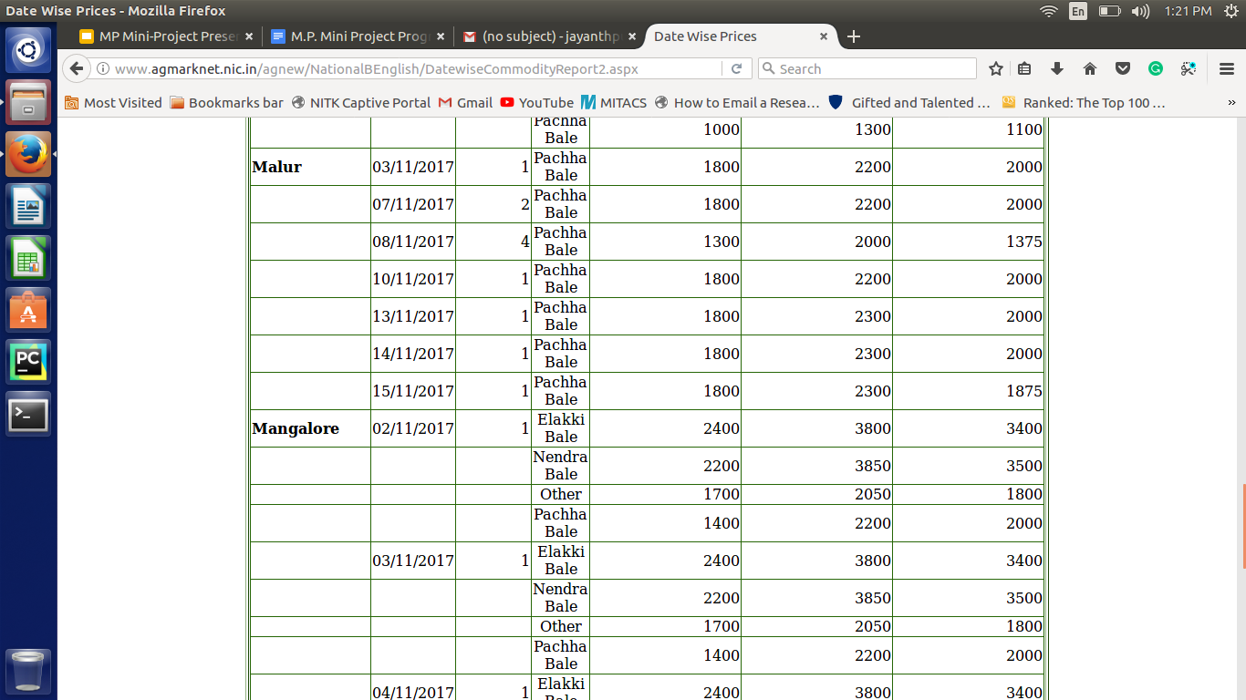

Slide 10
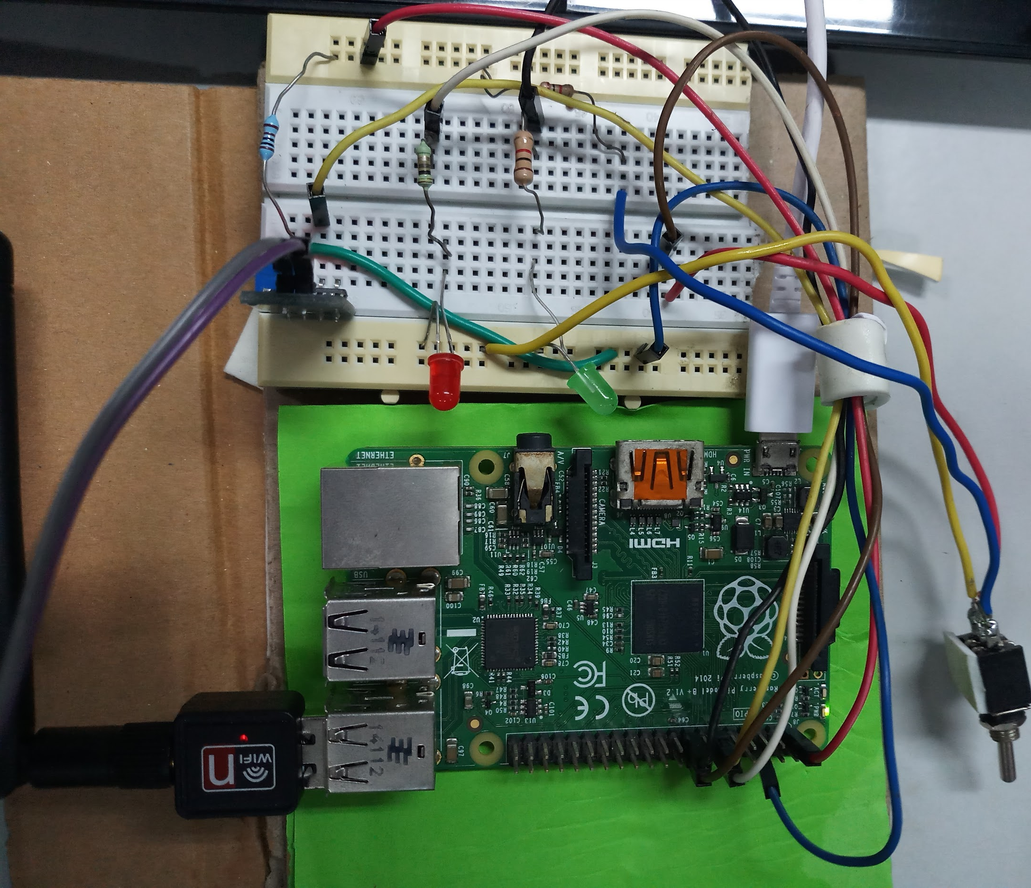
Irrigation - Smart Watering System
Sensors: Moisture, Weather data
Actuators: Mechanical Switch
Outputs: LEDs
Rain prediction data is mined from online, coupled with current moisture levels
Based on these readings, it is decided whether to turn on a servo motor or not (to turn on the irrigation system or not)

Slide 11
Extensions?

Slide 12
We could…
Make the transport system more robust. Multiple destinations, enter name of conductor, multiple buses, etc.
Expand on the healthcare system, by monitoring breathing rate, blood pressure, and adding a proximity/motion sensor
Understanding each individual crops’ requirements and controlling the irrigation system accordingly

Slide 13
Conclusion
Thus, an Internet of Things approach has been used to improve facilities of a village, such as Palampur.

Slide 14
Thank You.

